Slide 1
6AB – 27th – 30th April
Hello students, this week is shorter, Friday is the 1st of May which is an international holiday!
We are going to have one online lesson again on Tuesday 28th at 2 pm – we are going to practice the past tense and the irregular verbs, Deanna promised to join us too. This week I also prepared a TEST for you.
At the moment we finished Unit 3C and in Workbook we finished on page 28.
Připomínám domácí úkol na www.umimeanglicky.cz do 3. 5.

Slide 2
Lesson 1 – Revision of Simple past tense
You can use this Quizlet again for revision
https://quizlet.com/_8bi0jz?x=1qqt&i=2qvoee
Workbook p. 29
Exercise 4 - podle obrázků a nápovědy tvořte věty
Exercise 5 – převeďte text do minulého času.
Kontrola na další stránce

Slide 3
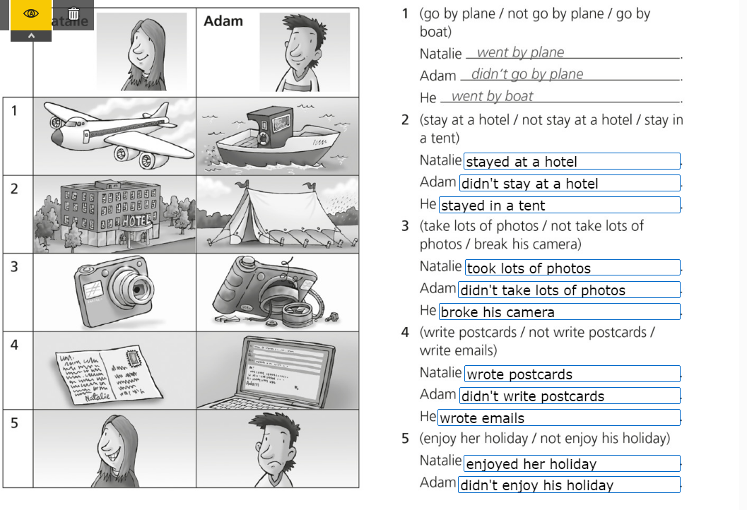
Kontrola WB 29/4
29/5

Slide 4
Lesson 2
– Online lesson, revision
Česky | Present | Past | Past Participle
odejít | leave | left | left
zapomenout | forget | forgot | forgotten
zlomit, rozbít | break | broke | broken
ukrást | steal | stole | stolen
 | fall over | fell over | fallen over
kousnout | bite | bit | bitten
ztratit | lose | lost | lost
cítit | feel | felt | felt
vzít | take | took | taken
dostat | get | got | got
jít | go | went | gone
mít | have | had | had
upadnout | fall | fell | fallen
moci, umět | can | could | could
číst | read | read | read
Now you know how to make past tense of regular verbs (+ed)
You know the irregular verbs in the table:
+ do, sit, run, fly, tell, teach

Slide 5
Lesson 3 - Past simple - TEST
Do this challenge on Kahoot – by 30th of April.
Do it only once please! You will get your results next week!
https://kahoot.it/challenge/04077385?challenge-id=16bc5da8-c458-4043-a046-ba03a74f7739_1587897349366
Game PIN: 04077385

Slide 6
3D – Mut´s holiday
Textbook p. 38 Read and listen to the story
Listening also here 38/1a
https://elt.oup.com/student/project/level2/unit3/audio?cc=cz&selLanguage=cs
In your exercise book:
Write new vocabulary from U3D (Workbook p. 82)
39/2 Finish the sentences – but write the whole sentence please.

Slide 7
That is all for this week!
1st of May is May Day – a holiday in Britain and in the USA
This is how they celebrate May Day in the US, watch the video, it is amazing what they can do with the ribbons.
https://www.youtube.com/watch?v=ncIAdeQGxoo

